Slide 1
Transitioning from TCE Reality vs Theory Taking the Lab to the Streets
Heidi Wilcox
TURI lab
978 934 3249
heidi@turi.org

Slide 2
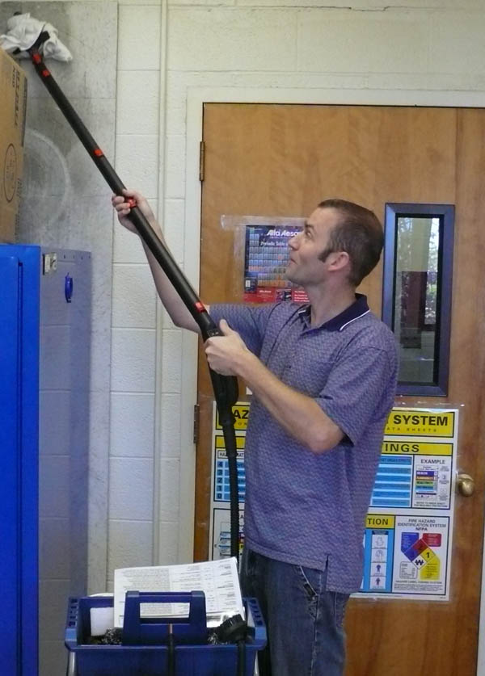
TURI Lab UMASS Lowell
Heard from my colleague/ boss/ friend
What we do, what we have done
How we do it
What tools we use for alt assessment
Case studies from the lab
What I want to discuss is Reality vs Theory
How to work in the field with experimental data & different companies cultures & needs

Slide 3
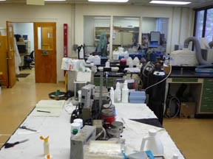
Theory – Lab or Office Alt Assess
Heard from Jason
What the lab has done over the years
How we do our alt assessments / our tools
When contacted or connected with a company
Send a test request form to understand process
See what is done before and after cleaning
Email company rep about other info needed
Do search of database & internet for options

Slide 4
Reality – Navigating Company Culture
Meet, find out about company, culture, process
Make relationships, listen
Talk about what they have tried, vendors worked with
Find out about goals for project
Drivers – regulatory, EH&S, management etc
Money talk, is there capital available
Talk about fears, client, testing needed etc
Gauge corporate backing
Take tour, talk to process people, need them!

Slide 5
Reality of the Substitution
TCE
Has great solvency, cost is relatively low
Hazardous but known, many have worked with TCE for long time, know how to use it
Solvent substitutions – interim step
We have seen mostly nPB
Good solvency, cost not out of reach
Drop in , adjust degreser settings
Got out of regs then but need to move again
Have built relationships, trust & partnership

Slide 6
Reality in its Infancy
Interim step leads to trust, collaboration
When new regs knock on door, they are less scared & know our process, Trust us
Move to other process can be involved
Need to go slow
Listen to companies & workers concerns
Acknowledge they are their process experts
Im there as another resource, a bridge to contractors& help oversee / manage project
Testing issues of clients

Slide 7
Needs of Process in Reality
Solvents cleaned well, worry new system wont
Solvent process known, new unknown
Solvents, work for clients & their process
No rinse & dry needed
Readily evaporative, no heavy residues
Protect against corrosion, rusting, remove fines
Quick process generally
Forgiving process from training prospective
Aqueous or Semi process unknown so scary to them & clients.

Slide 8
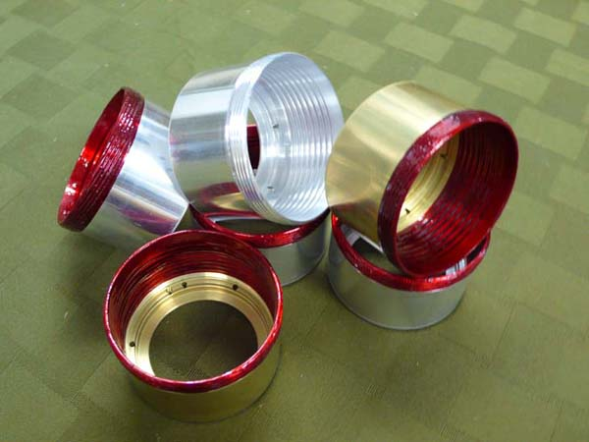
Lessons Learned in Reality
Every company is different even
Culture
Set up of process
Needs of the company for project
Capital they have to spend
Space
Management support
Workers, clients needs
How much testing is required for clients
Depends if FDA, Military & Aerospace

Slide 9
Generalizations in Reality
None really – every company is different
Basics – there can be an alternative
Depends on how committed;
People who hold purse strings are
Floor management openness
Worker buy in, makes it easier if they feel involved
Drop-ins easier for company to deal with
Low EH&S, high tech adoption /training, low cost
Aqueous & semi Aqueous harder for company
High EH&S, harder tech & cost for company
Slower due to testing needed

Slide 10
In Reality Always an Alternative
Solvent to solvent options - easier
New system
Aqueous, semi, media blasting, CO2
There are other options besides substitution
Change process
Work with supply chain have parts or stock come in clean
Ask customer to clean parts instead of you
Buy high tech, automated machines to reduce handling of parts & exposure to chemicals

Slide 11
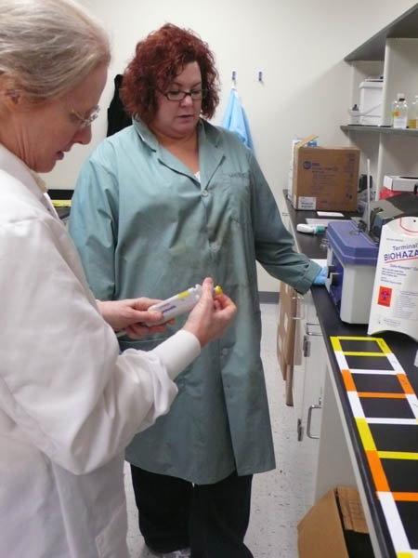
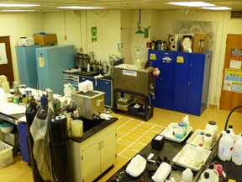
Reality Always Wins
Thank you
Heidi Wilcox
Head Field Scientist
TURI Lab/ UMASS
978- 934 3249
Heidi@turi.org

