Slide 1



Energy Conservation Planning Under the Toxics Use Reduction Act
March 25, 2026

Slide 2
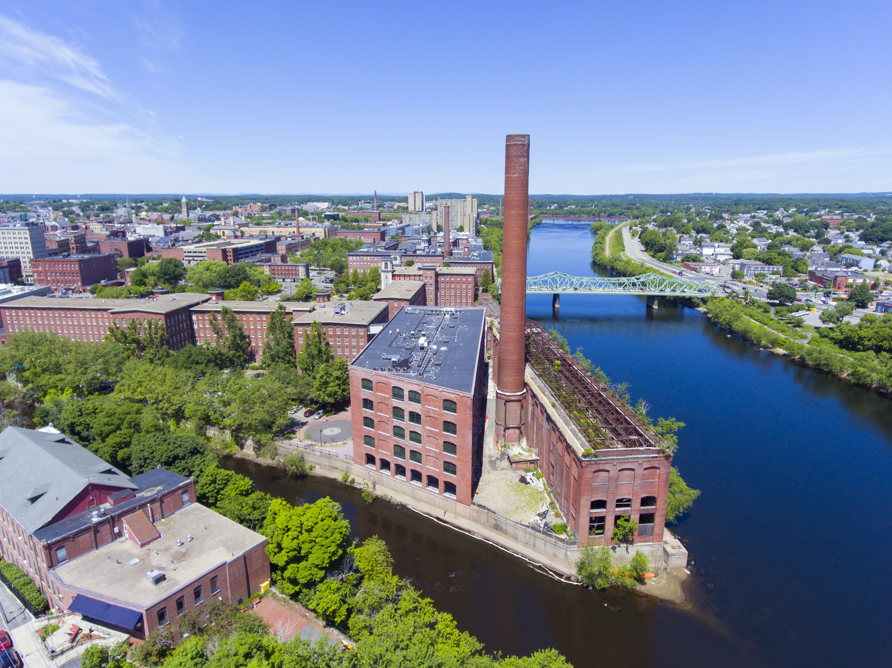
Overview
Resource Conservation Planning
Technical Services and MassSave Updates – John Raschko, OTA
Energy Intelligence for Massachusetts Manufacturers – Dan Flamand, PowerPlay Energy Group
Notes:
Grand Total
54,960.72
6,609,038.64
1,864,814.72

Slide 3
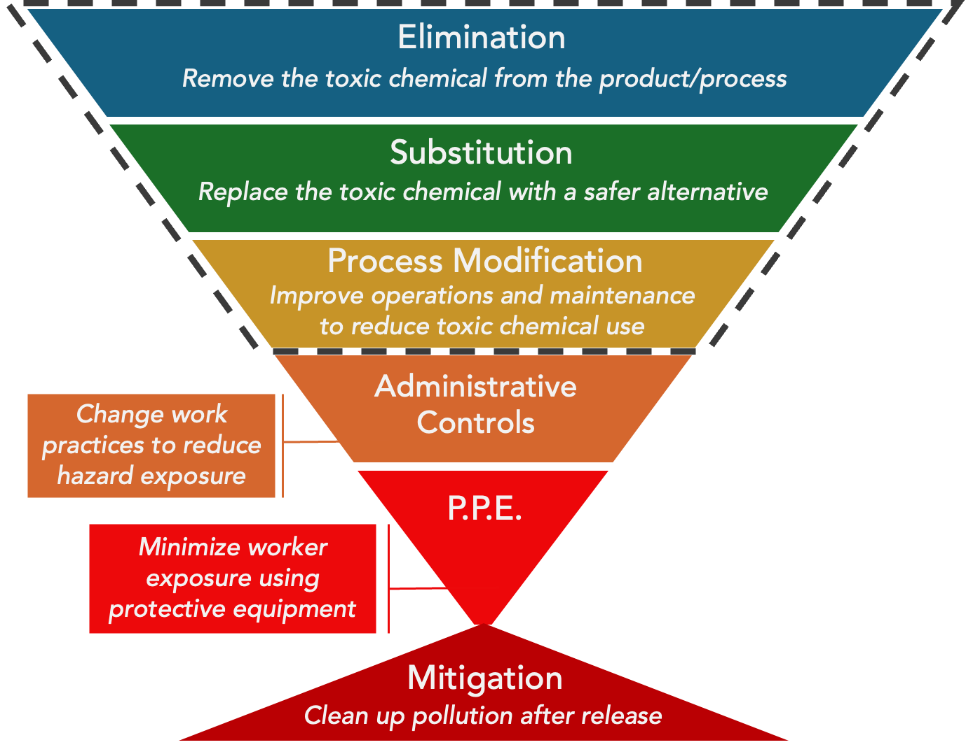



The Toxics Use Reduction Act of Massachusetts (TURA)
The Toxics Use Reduction (TUR) Approach
TUR
Report their use of chemicals on the TURA list of toxic substances
Conduct Toxics Use Reduction Planning using a certified planner
Pay fee based on number of employees and reportable chemicals
The TURA list of Toxic Substances can be updated
TURA does not ban or restrict any chemicals

Slide 4




2006 Amendments
Resource conservation
Decrease the use or consumption of a natural asset without increasing risk to the public, workers, consumers or environment, and without increasing the amount of waste generated
Designed to provide flexibility and opportunity to incorporate TUR into overall sustainability goals
Facilities that have completed one TUR plan and at least two plan updates may choose to:
Continue with TUR Planning
Implement a TURA EM
Conduct Resource Conservation Planning

Slide 5
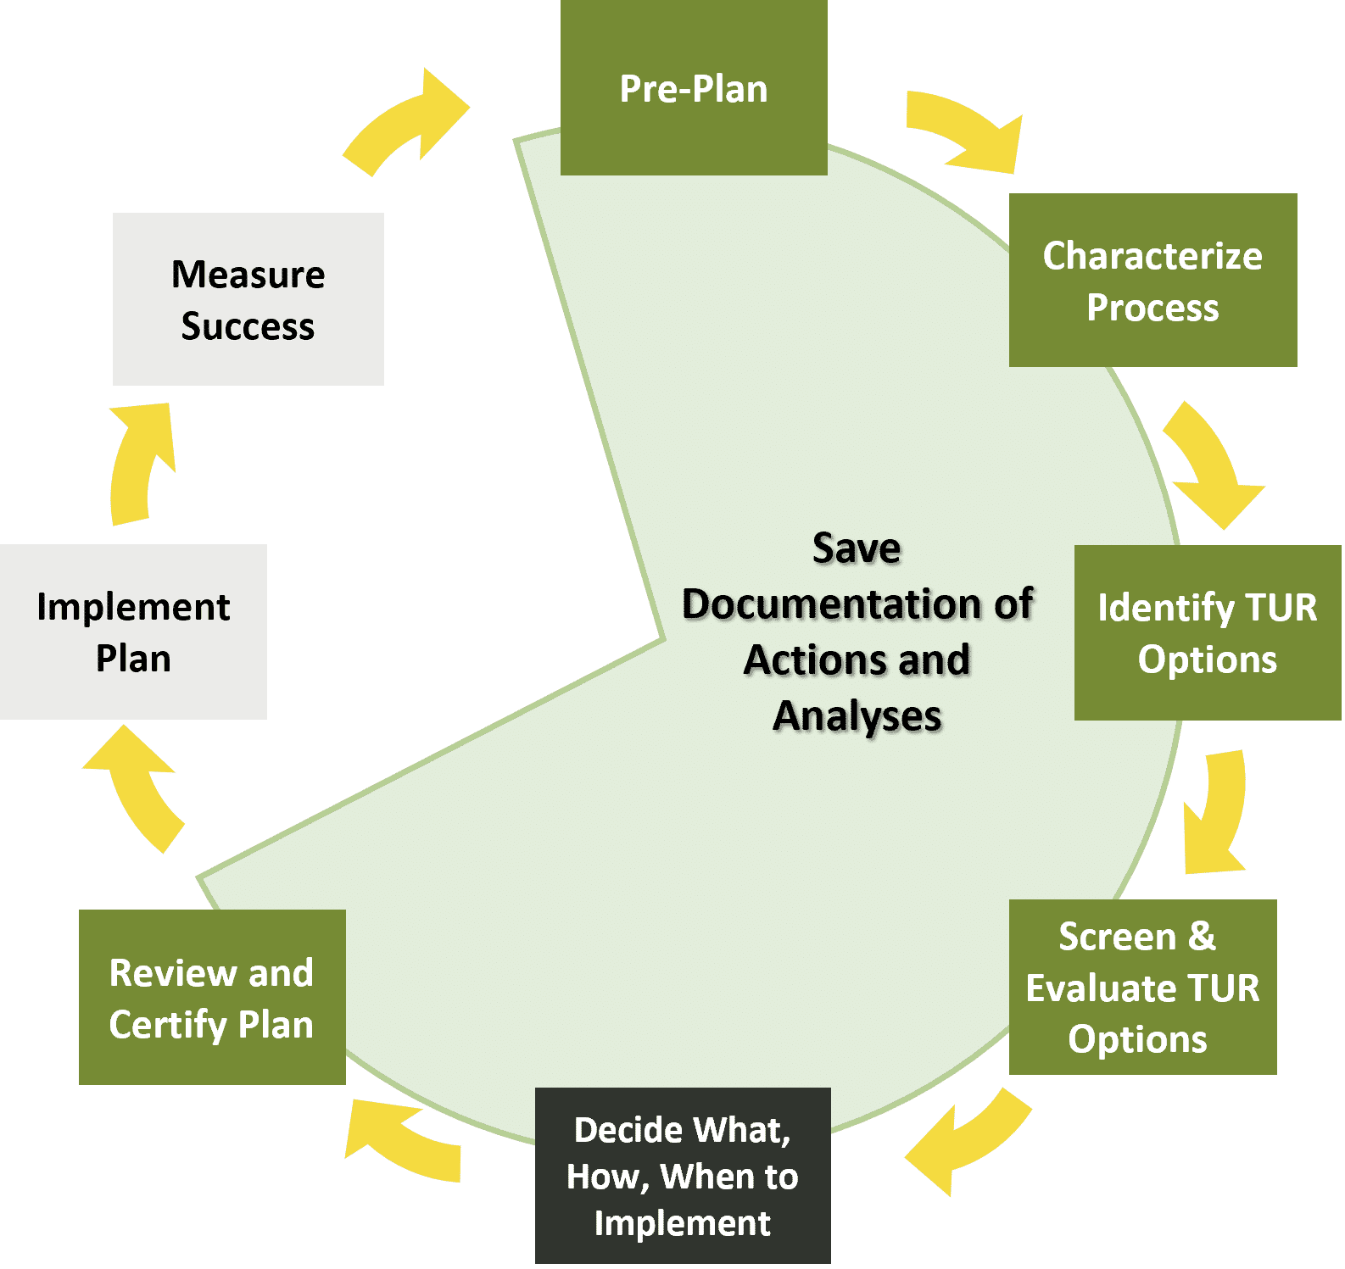
Overview of Energy Conservation Planning
Find and organize energy data
Identify energy conservation options
Screen and evaluate!
Notes:
BPRC

Slide 6





Common Areas for Energy Conservation
Reducing demand through conservation and efficiency
Energy supply management
Energy related to products and services
E.g., switching to renewable sources, combined heat and power systems, load management
E.g., compressed air systems, boilers, ventilation, HVAC, motors, process heat, pumps
E.g., fleet vehicles, mileage and travel, commuting incentives
Reductions in operational costs and improving productivity
Reduction in use of other natural assets and increased resilience

Slide 7
Resources
Massachusetts Office of Technical Assistance and Technology: https://www.mass.gov/orgs/office-of-technical-assistance-and-technology-ota
Mass Save: https://www.masssave.com/
Energy Star Program: https://www.energystar.gov/
U.S. DOE Office of Energy Efficiency and Renewable Energy: https://www.energy.gov/eere
Northeast Energy Efficiency Partnerships (NEEP): https://www.neep.org/
Massachusetts Clean Energy Center: https://www.masscec.com/
Notes:
In summary – when you are investing, companies that are actively participating in TUR present an opportunity to achieve EJ goals, and to gain returns on investment
TURI is a resource to help identify companies, as a partner to implement TUR projects as an investment condition, and as a partner to help communicate to businesses, especially those in EJ companies, that opportunities exist for investment in funding if they engage in TUR.

Slide 8
Thank you and see you soon!
Please complete the post-webinar survey, required for CEUs!
April 8, 2026, 8:30 – 4:30 pm
Toxics Use Reduction Spring Conference
12 CEUs!
April 23, 2026, 3:00 – 5:00 pm
Water Conservation – Webinar
4 CEUs! Resource Conservation!
May 21, 2026, 1:00 – 3:00 pm
Source Reduction for Industrial Waste – Webinar
4 CEUs! Resource Conservation!
Events: https://www.turi.org/training-and-education/
Notes:
In summary – when you are investing, companies that are actively participating in TUR present an opportunity to achieve EJ goals, and to gain returns on investment
TURI is a resource to help identify companies, as a partner to implement TUR projects as an investment condition, and as a partner to help communicate to businesses, especially those in EJ companies, that opportunities exist for investment in funding if they engage in TUR.

