Slide 1

Mass. Office of Technical Assistance
Overview & Energy Conservation Resources
John S. Raschko, Ph.D.
Sr. Engineer, Massachusetts Office of Technical Assistance
RC Planning - Energy Conservation Webinar
March 25, 2026
Notes:
8:45

Slide 2
TURA Program Implementation
MassDEP
Regulatory
TURI
Research & Grants
OTA
Confidential Technical Assistance
The TURA Program is co-implemented by:
  The Massachusetts Department
  of Environmental Protection
  The Massachusetts Office
  of Technical Assistance
  The Toxics Use Reduction Institute
  at UMass Lowell
TURA is a state law, not a federal law.
OTA, DEP, and TURI are not part of EPA.

Slide 3
Office of Technical Assistance (OTA)
  Non-regulatory agency
  Provides free, confidential technical and compliance assistance to MA businesses that use toxic substances
  Gives concrete recommendations for toxics reduction and resource conservation
  OTA has conducted 3,500 site visits at 1,500 facilities,
  reducing millions of pounds of toxic chemicals
  and millions of dollars in operating costs.

Slide 4

OTA Technical Assistance
OTA can assist facilities with:
  Toxics use reduction
  Environmental compliance
  Energy efficiency
  Resource conservation
Both onsite and remote
assistance are available
After a site visit, OTA delivers tailored recommendations

Slide 5
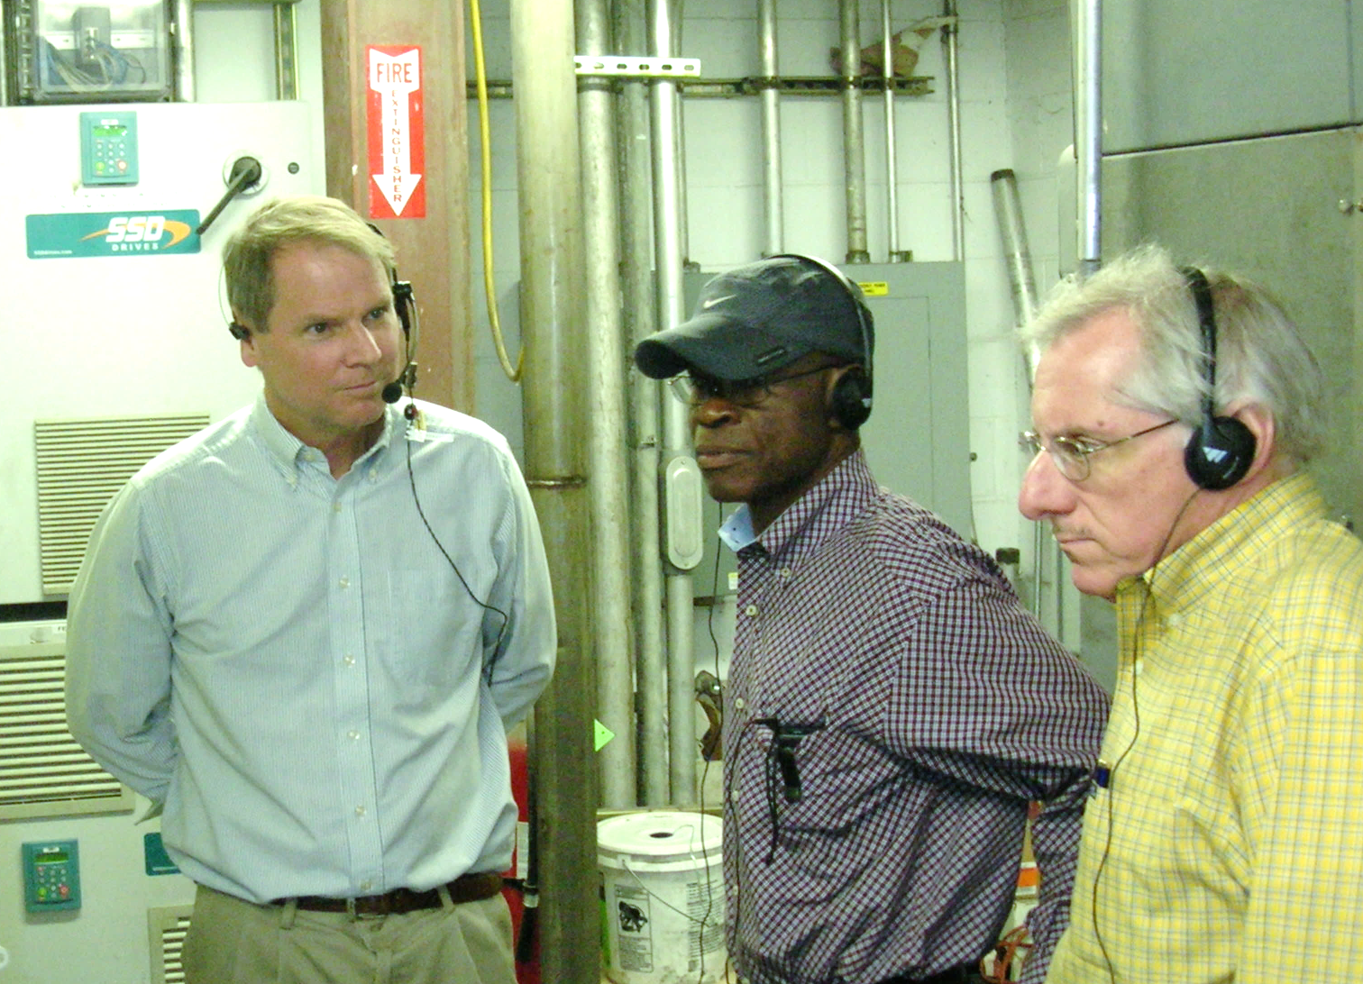
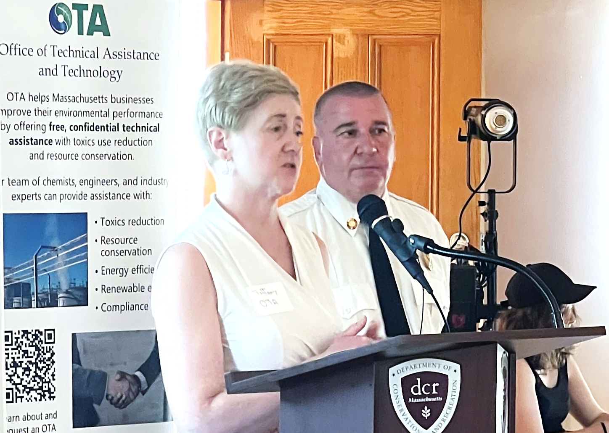
OTA Staff
Chemists, engineers, and public health professionals
Hands-on manufacturing experience
OTA understands:
Health and safety
The bottom line
Regulatory requirements
How to implement change

Slide 6
OTA Energy Efficiency Services
  Electric bill analysis – focus on demand charges (including effect of power factor on them) & demand management
  Identify energy efficiency opportunities – focus on process energy use, e.g., compressed air, steam systems, fan systems, ovens
  Referrals for energy audits - Industrial Training & Assessment Center @ UConn (Storrs), energy services companies
  Referrals to energy efficiency incentives –
    Mass Save – National Grid, Eversource, Unitil, Cape Light Compact, Liberty Utilities, Berkshire Gas
    Municipal provider programs

Slide 7
Mass Save 2026 Incentives for Business
Manufacturing – e.g., Efficient Lighting Design, VSDs & Motor Upgrades, Building Management Systems (BMS), Heating & Cooling Equipment Upgrades
Products & Services – e.g., Energy Assessments & Technical Assistance, Custom Incentives & Technical Support, Heating & Cooling, Existing Building & Monitoring-Based Commissioning
Energy Assessments & Technical Assistance
  Small Business Customers – e.g., No-cost energy assessments, Commercial Heat Pump Consultation
  Large Commercial & Industrial Customers – e.g., Scoping Study (existing buildings), Specialty Studies (e.g., steam traps, compressed air), Comprehensive Building Assessment
Notes:
Custom Incentives - Incentives for equipment and measures not covered by standard incentives. These projects typically require additional energy analysis or other technical assistance. Includes projects that involve new construction, major renovations, installation of new, unique high efficiency equipment, or replacing existing equipment with new, higher efficiency models. Use the Custom Project Application.
Technical Assistance & Engineering Services - Support for businesses in implementing customized energy efficiency projects—including quantifying how much energy is projected to be saved at project completion. Are qualified, independent engineers and consultants to help quantify the savings and incentive potential of customized energy efficiency projects. Mass Save pays up to 50 percent of the cost for these services.
Existing Building & Monitoring-Based Commissioning - Mass Save’s commissioning offers will help prolong the life of equipment and ensure building systems are performing at their best. EBCx is an in-depth process for commercial customers to optimize their building’s performance. The EBCx offer aims to support customers undertaking commissioning to identify energy savings opportunities by optimizing performance of existing building systems. Common measures identified include improvements in building control, component repairs, and sensor calibrations. Program Pays incentives for implemented and verified measures of $0.17/kWh and $1.20/therm on top of study payments. MBCx Ensures equipment, systems, or building conditions continue to operate at their optimal efficiency through continuous monitoring and analysis of building data and tune-ups. Website under construction.
Energy Assessments & Technical Assistance
Small Business Customers – several options for businesses using less than 1.5 million kWh in annual electric usage or less than 40,000 therms annually on natural gas bills. No-cost in-person energy assessments - Recommended upgrades may include air sealing & weatherization, HVAC system upgrades, lighting system upgrades and more, paid for up to 70 percent by Mass Save. Virtual no-cost Commercial Heat Pump Consultation with a Heat Pump Specialist to assist with: Understanding how heat pumps and Variable Refrigerant Flow (VRF) systems work; Guidance on the best solution for your business; Navigating the rebate process; and Reviewing and comparing quotes.
Large Commercial & Industrial Customers - qualified, independent engineers and consultants help quantify the savings and incentive potential of customized energy efficiency projects for large commercial & industrial properties. Early quick studies explore solutions that help identify savings opportunities quickly – Scoping studies identify opportunities for existing buildings (lighting system upgrades, refrigeration controls and cooler upgrades, motor or drive controls, compressed air systems, and more) Comprehensive Building Assessments a deeper dive into reducing a building’s carbon emissions with electrification and energy efficiency measures. Up to 100% of the study cost may be covered when working with a prequalified vendor. Financial Grade analyses explore solutions that refine the benefits of potential projects and inform incentives from Mass Save. Focused Studies provide precise cost, savings and emissions impact estimates for selected energy efficiency or decarbonization measures, along with documentation required to complete a Mass Save custom incentive application. Up to 50% of the study cost may be covered when working with a prequalified vendor. Specialty Studies are designed to address specific systems such as steam traps, commercial refrigeration, and compressed air systems. Up to 100% of study costs covered when measures are adopted,
e

Slide 8
Mass Save Resources
Mass Save Sponsor Directory for C&I Projects
Instant Lighting Incentives
Upgrade Large Commercial Existing Lighting
Heating & Cooling Equipment Upgrades
Custom Incentives & Technical Support
Existing Building & Monitoring-Based Commissioning
Small Business No-cost energy assessments (with request form)
Commercial Heat Pump Consultation
Massachusetts Energy Efficiency Partnership (MAEEP)

Slide 9

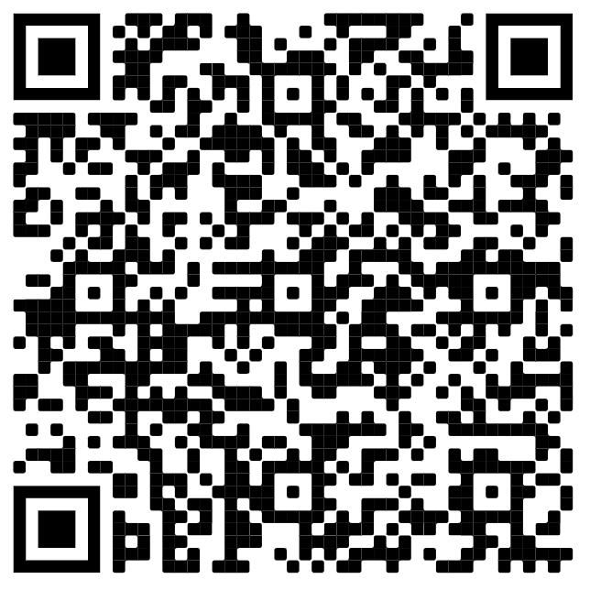
Contact Us
John S. Raschko, Ph.D.
Sr. Engineer
John.raschko@mass.gov
Website: mass.gov/ota
Office of Technical Assistance
Sign up for OTA’s newsletter!
Scan this QR code:
Or visit
bit.ly/OtaNewsletter

